Slide 1
Base hit in Right Field Runner on 2nd base

Slide 2
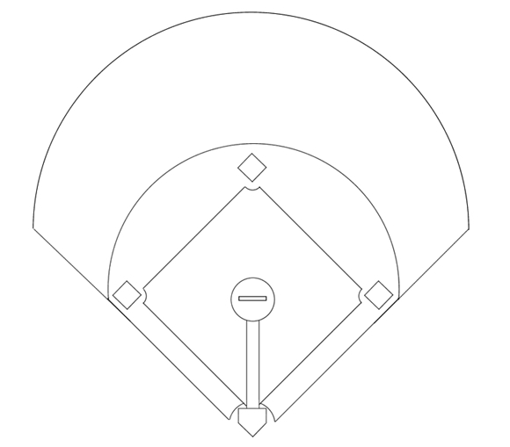
1
Pitcher
2
Catcher
8
3
1e Baser
4
2nd Baser
5
3rd Baser
7
9
6
Short Stop
7
Left Fielder
6
4
8
Center Fielder
9
Right Fielder
5
3
1
Base hit in right field. Runner on third scores.
2

Slide 3
1
Pitcher
2
Catcher
8
3
1e Baser
4
2nd Baser
5
3rd Baser
7
9
6
Short Stop
7
Left Fielder
6
4
8
Center Fielder
9
Fields the ball
5
3
1
Batter rounds first base.
2

Slide 4
1
Pitcher
2
Catcher
8
3
1e Baser
4
2nd Baser
5
3rd Baser
7
9
6
Short Stop
7
Left Fielder
6
4
8
Center Fielder
9
Fields the ball
5
3
1
Batter rounds first base. Runner rounds third base.
2

Slide 5
1
Pitcher
2
Catcher
8
3
1e Baser
4
2nd Baser
5
3rd Baser
7
9
6
Short Stop
7
Left Fielder
6
4
8
Covers 9
9
Fields the ball
5
3
1
Batter rounds first base. Runner rounds third base.
2

Slide 6
1
Pitcher
2
Catcher
8
3
Takes cutoff pos.
4
2nd Baser
5
3rd Baser
7
9
6
Short Stop
7
Left Fielder
6
4
8
Covers 9
9
Fields the ball
5
3
1
2

Slide 7
1
Pitcher
2
Takes homeplate
8
3
Takes cutoff pos.
4
2nd Baser
5
3rd Baser
7
9
6
Short Stop
7
Left Fielder
6
4
8
Covers 9
9
Fields the ball
5
3
1
2

Slide 8
1
Covers homeplate
2
Takes homeplate
8
3
Takes cutoff pos.
4
2nd Baser
5
3rd Baser
7
9
6
Short Stop
7
Left Fielder
6
4
8
Covers 9
9
Fields the ball
5
3
1
2

Slide 9
1
Covers homeplate
2
Takes homeplate
8
3
Takes cutoff pos.
4
2nd Baser
5
Takes 3rd base
7
9
6
Short Stop
7
Left Fielder
6
4
8
Covers 9
9
Fields the ball
5
3
1
5 keeps an eye on the runner. Ready to cover 1 on a wild throw.
2

Slide 10
1
Covers homeplate
2
Takes homeplate
8
3
Takes cutoff pos.
4
2nd Baser
5
Takes 3rd base
7
9
6
Takes 2nd base
7
Left Fielder
6
4
8
Covers 9
9
Fields the ball
5
3
1
2

Slide 11
1
Covers homeplate
2
Takes homeplate
8
3
Takes cutoff pos.
4
Takes 1st base
5
Takes 3rd base
7
9
6
Takes 2nd base
7
Left Fielder
6
4
8
Covers 9
9
Fields the ball
5
3
1
2

Slide 12
1
Covers homeplate
2
Takes homeplate
8
3
Takes cutoff pos.
4
Takes 1st base
5
Takes 3rd base
7
9
6
Takes 2nd base
7
Covers 3rd base
6
4
8
Covers 9
9
Fields the ball
5
3
1
2

Slide 13
1
Covers homeplate
2
Takes homeplate
8
3
Takes cutoff pos.
4
Takes 1st base
5
Takes 3rd base
7
9
6
Takes 2nd base
7
Covers 3rd base
6
4
8
Covers 9
9
Fields the ball
5
3
2
1

Slide 14
1
Covers homeplate
2
Takes homeplate
8
3
Takes cutoff pos.
4
Takes 1st base
5
Takes 3rd base
7
9
6
Takes 2nd base
7
Covers 3rd base
6
4
8
Covers 9
9
Fields the ball
5
3
Runners decide to advance an extra base or to return. Runners keep an eye on the defensive play: advance on the throw if possible
2
1

Slide 15
1
Covers homeplate
2
Takes homeplate
8
3
Takes cutoff pos.
4
Takes 1st base
5
Takes 3rd base
7
9
6
Takes 2nd base
7
Covers 3rd base
6
4
8
Covers 9
9
Fields the ball
5
3
9 throws home
2
1

Slide 16
1
Covers homeplate
2
Takes homeplate
8
3
Takes cutoff pos.
4
Takes 1st base
5
Takes 3rd base
7
9
6
Takes 2nd base
7
Covers 3rd base
6
4
8
Covers 9
9
Fields the ball
5
3
9 throws home ...or to 2nd base if no action is possible at home.
2
1

Slide 17
1
Covers homeplate
2
Takes homeplate
8
3
Takes cutoff pos.
4
Takes 1st base
5
Takes 3rd base
7
9
6
Takes 2nd base
7
Covers 3rd base
6
4
8
Covers 9
9
Fields the ball
5
X
3
If so directed: 3 cuts the ball and checks the runners or throws as directed
2
1

Slide 18
1
Covers homeplate
2
Takes homeplate
8
3
Takes cutoff pos.
4
Takes 1st base
5
Takes 3rd base
7
9
6
Takes 2nd base
7
Covers 3rd base
6
4
8
Covers 9
9
Fields the ball
5
X
3
3 throws to 1st, 2nd, 3rd, home or holds on to the ball.
2
1

Slide 19
1
Covers homeplate
2
Takes homeplate
8
3
Takes cutoff pos.
4
Takes 1st base
5
Takes 3rd base
7
9
6
Takes 2nd base
7
Covers 3rd base
6
4
8
Covers 9
9
Fields the ball
5
3
Never throw behind the runner if he's not returning.
The runner can still advance on the throw.
2
1

