Slide 1
Base hit in Right Field No runners

Slide 2
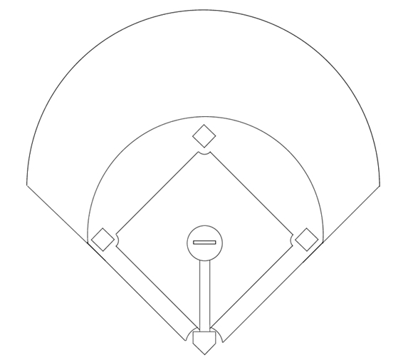
1
Pitcher
2
Catcher
8
3
1e Baser
4
2nd Baser
5
3rd Baser
7
9
6
Short Stop
7
Left Fielder
6
4
8
Center Fielder
9
Right Fielder
5
3
1
Base hit in right field. Runner on third scores.
2

Slide 3
1
Pitcher
2
Catcher
8
3
1e Baser
4
2nd Baser
5
3rd Baser
7
9
6
Short Stop
7
Left Fielder
6
4
8
Center Fielder
9
Fields the ball
5
3
1
Batter rounds first base.
2

Slide 4
1
Pitcher
2
Catcher
8
3
1e Baser
4
2nd Baser
5
3rd Baser
7
9
6
Short Stop
7
Left Fielder
6
4
8
Covers 9
9
Fields the ball
5
3
1
2

Slide 5
1
Pitcher
2
Catcher
8
3
1e Baser
4
2nd Baser
5
3rd Baser
7
9
6
Takes 2nd base
7
Left Fielder
6
4
8
Covers 9
9
Fields the ball
5
3
1
2

Slide 6
1
Pitcher
2
Catcher
8
3
1e Baser
4
Takes cutoff pos.
5
3rd Baser
7
9
6
Takes 2nd base
7
Left Fielder
6
4
8
Covers 9
9
Fields the ball
5
3
1
2

Slide 7
1
Pitcher
2
Catcher
8
3
Moves away
4
Takes cutoff pos.
5
3rd Baser
7
9
6
Takes 2nd base
7
Left Fielder
6
4
8
Covers 9
9
Fields the ball
5
3
1
Lures the runner away from the base.
2

Slide 8
1
Takes 1e base
2
Catcher
8
3
Moves away
4
Takes cutoff pos.
5
3rd Baser
7
9
6
Takes 2nd base
7
Left Fielder
6
4
8
Covers 9
9
Fields the ball
5
3
1
2

Slide 9
1
Takes 1e base
2
Covers 1e base
8
3
Moves away
4
Takes cutoff pos.
5
3rd Baser
7
9
6
Takes 2nd base
7
Left Fielder
6
4
8
Covers 9
9
Fields the ball
5
3
1
2

Slide 10
1
Takes 1e base
2
Covers 1e base
8
3
Moves away
4
Takes cutoff pos.
5
3rd Baser
7
9
6
Takes 2nd base
7
Covers 2nd base
6
4
8
Covers 9
9
Fields the ball
5
3
1
2

Slide 11
1
Takes 1e base
2
Covers 1e base
8
3
Moves away
4
Takes cutoff pos.
5
Covers 2nd base
7
9
6
Takes 2nd base
7
Covers 2nd base
6
4
8
Covers 9
9
Fields the ball
5
3
1
2

Slide 12
1
Takes 1e base
2
Covers 1e base
8
3
Moves away
4
Takes cutoff pos.
5
Covers 2nd base
7
9
6
Takes 2nd base
7
Covers 2nd base
6
4
8
Covers 9
9
Fields the ball
5
3
1
Runner decides to advance or to return to 1e base.
1 and 6 call out directions
2

Slide 13
1
Takes 1e base
2
Covers 1e base
8
3
Moves away
4
Takes cutoff pos.
5
Covers 2nd base
7
9
6
Takes 2nd base
7
Covers 2nd base
6
4
8
Covers 9
9
Fields the ball
5
3
1
9 throws to 2nd base - via the cutoff.
2

Slide 14
1
Takes 1e base
2
Covers 1e base
8
3
Moves away
4
Takes cutoff pos.
5
Covers 2nd base
7
9
6
Takes 2nd base
7
Covers 2nd base
6
4
8
Covers 9
9
Fields the ball
5
3
1
...or towards 1e base if
the runner took a big lead and is returning (slowly) to 1e base.
2

Slide 15
1
Takes 1e base
2
Covers 1e base
8
3
Moves away
4
Takes cutoff pos.
5
Covers 2nd base
7
9
6
Takes 2nd base
7
Covers 2nd base
6
4
8
Covers 9
9
Fields the ball
5
3
1
Never throw behind the runner if he's not returning.
The runner can still advance on the throw.
2

Slide 16
1
Takes 1e base
2
Covers 1e base
8
3
Moves away
4
Takes cutoff pos.
5
Covers 2nd base
7
9
6
Takes 2nd base
X
7
Covers 2nd base
6
4
8
Covers 9
9
Fields the ball
5
3
1
If so directed: 4 cuts the ball and checks the runner
2

Slide 17
1
Takes 1e base
2
Covers 1e base
8
3
Moves away
4
Takes cutoff pos.
5
Covers 2nd base
7
9
6
Takes 2nd base
X
7
Covers 2nd base
6
4
8
Covers 9
9
Fields the ball
5
3
1
4 throws to 1st, 2nd or holds on to the ball.
2

