Slide 1
Field positions

Slide 2
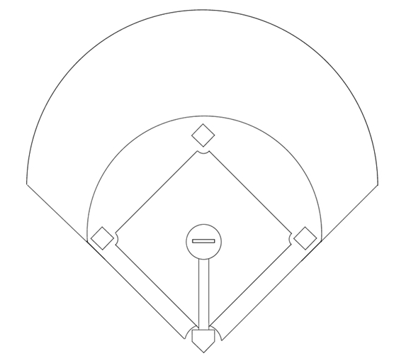
1
Pitcher
2
Catcher
Center Fielder
3
1e Baser
4
2nd Baser
5
3rd Baser
Left Fielder
Right Fielder
6
Short Stop
7
Left Fielder
Short Stop
2nd Baser
8
Center Fielder
9
Right Fielder
3rd Baser
1e Baser
Pitcher
Catcher

Slide 3
1
Pitcher
2
Catcher
8
3
1e Baser
4
2nd Baser
5
3rd Baser
7
9
6
Short Stop
7
Left Fielder
6
4
8
Center Fielder
9
Right Fielder
5
3
1
2

Slide 4
1
Pitcher
2
Catcher
8
3
1e Baser
4
2nd Baser
10
5
3rd Baser
7
9
6
Short Stop
7
Left Fielder
6
4
8
Center Fielder
9
Right Fielder
10
Mid Fielder
5
3
1
Slowpitch has a 10th player.
who plays shallow outfield
2

Slide 5
1
Pitcher
2
Catcher
8
10
3
1e Baser
4
2nd Baser
5
3rd Baser
7
9
6
Short Stop
7
Left Fielder
6
4
8
Center Fielder
9
Right Fielder
10
Mid Fielder
5
3
1
Slowpitch has a 10th player.
...or center field
2

Slide 6
Runner on Third

Slide 7
1
Pitcher
2
Catcher
8
3
1e Baser
4
2nd Baser
5
3rd Baser
7
9
6
Short Stop
7
Left Fielder
6
4
8
Center Fielder
9
Right Fielder
5
3
1
Runner on third base
will nearly always score
on a base hit in the outfield.
2

